Slide 1
Optical switching networks

Slide 2
Optical switching networks
Optical networks come in many flavors
  Different topologies (star, ring, mesh, …)
  Transparent, opaque, and translucent architectures
  Different multiplexing approaches (TDM, SDM, WDM)
  Tunable devices (transmitters, filters, wavelength converters)
  Reconfigurable devices (ROADMs & ROXCs)
Various multiplexing, tuning, and switching techniques enable single- or multichannel optical switching networks with
  High flexibility
  Dynamic (re)configuration capability in response to varying traffic loads and network failures

Slide 3
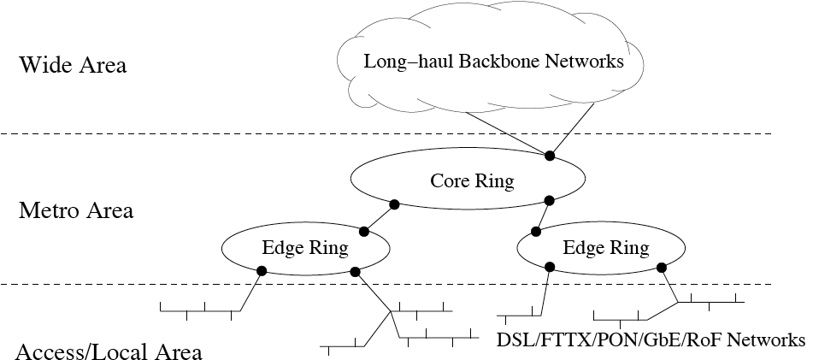
Optical switching networks
End-to-end optical networks
  Optical switching networks widely deployed in today’s wide, metro(politan), access, and local area networks
  Both telcos & cable providers steadily move fiber-to-copper discontinuity point toward end users

Slide 4
Optical switching networks
First/last mile bottleneck
  Typically, phone companies deploy digital subscriber line (DSL) based solutions while cable providers deploy cable modems in their access networks
  Both approaches make use of copper-based final network segment to connect subscribers
  Copper-based access segment forms bandwidth bottleneck between high-capacity optical backbone networks & increasingly higher-speed clients at network periphery
  Bottleneck commonly referred to as first or last mile bottleneck

Slide 5
Optical switching networks
FTTX
  To mitigate or remove first/last mile bottleneck, fiber is brought close or all the way to business & residential subscribers
  Depending on demarcation point X of fiber, this leads to so-called fiber to the X (FTTX) networks
  Examples of FTTX networks
    Fiber to the building (FTTB)
    Fiber to the home (FTTH)
    Fiber to the curb (FTTC)
    Fiber to the neighborhood/node (FTTN)

Slide 6
Optical switching networks
PON
  FTTX networks typically realized as so-called passive optical networks (PONs)
  PONs consist of passive optical components without using amplifiers or any other powered devices
  Benefits of PONs
    Provide low capital expenditures (CAPEX) and operational expenditures (OPEX)
    Simplify network operation, administration, and maintenance (OAM)
    Simplify network management
  PONs come in different flavors
    ATM-based PONs (APON, BPON, GPON)
    Ethernet PON (EPON)

Slide 7
Optical switching networks
ATM vs. Ethernet PONs
  At present, access networks are fastest growing sector of communications networks
  Optical access networks play key role in providing broadband access
  Cost reduction currently more important than capacity and speed increase
  EPON appears to be in advantageous position over ATM based PONs due to
    Low cost & simplicity of Ethernet
    Wide deployment of Ethernet LAN technology & products

Slide 8
Optical switching networks
10GbE LAN
  Ethernet is predominant technology in today’s local area networks (LANs)
  Line rate and transmission range of Ethernet LANs steadily increased over last few years
  State-of-the-art 10 Gigabit Ethernet (10GbE) provides maximum transmission range of 40 km over optical fiber
  Besides LAN applications, 10GbE considered a promising low-cost solution for optical high-speed MANs & WANs
    10GbE equipment costs about 80% lower than that of SONET equipment
    10GbE services expected to be priced 30-60% lower than other managed network services
  Ethernet technology has potential to build end-to-end Ethernet optical networks

Slide 9
Optical switching networks
Optical-wireless access networks
  Current access networks are either optical or wireless
  Pros & cons of optical access networks
    Provide practically unlimited bandwidth
    Require fiber cabling & do not go everywhere
  Pros & cons of wireless access networks
    Enable mobility & reachability of users
    Provide rather limited bandwidth
  Future access networks likely to be bimodal combining merits of optical & wireless technologies => radio-over-fiber (RoF) networks
  RoF networks may be viewed as final frontier of optical networks interfacing with their wireless counterparts

Slide 10
Optical switching networks
Applications
  Many of today’s applications can be categorized into
    Latency-critical applications
      Small- to medium-size file transfers with low-latency requirements
      Examples: Broadcast television, interactive video, video conferencing, security video monitoring, interactive games, telemedicine, and telecommuting
    Throughput-critical applications
      Large-size file transfers requiring much bandwidth with relaxed latency constraints
      Examples: Video on demand (VoD), video & still-image email attachments, backup of files, program & file sharing, and file downloading (e.g., books)

Slide 11
Optical switching networks
Applications: Impact
  Applications have significant impact on throughput-delay performance requirements & traffic loads of optical networks
  Examples
    Web browsing
      Based on client-server paradigm
      Clients send short request messages to server for downloading data files of larger size => asymmetric traffic loads
    P2P applications
      Steadily growing P2P traffic
      P2P traffic already represents major traffic load in some existing access networks
      Each client also acts as server => more symmetric traffic loads
    HDTV, Grid computing, …

Slide 12
Optical switching networks
Services
  To support wide range of applications, optical networks provide connection-oriented & connectionless services
    Connection-oriented services
      Handshake procedure between source & destination required to establish connection before data transmission
      Sender & destination (e.g., TCP) and possibly also intermediate nodes (e.g., ATM, MPLS) need to maintain state information for established connection
      State information enables recover from data loss and QoS support for applications with different SLAs
    Connectionless services
      No connection establishment needed to send data
      Connectionless services (e.g., IP) well suited for transfer of best-effort traffic

Slide 13
Optical switching networks
Services
  Examples
    Triple-play
      Bidirectional voice, bidirectional data, and unidirectional video services delivered to residential & business users by cable companies
    Virtual private network (VPN)
      Closed community of authorized users to access various network-related services & resources
      Similar to leased private lines, VPNs provide privacy by isolating traffic of different VPNs from each other
      Virtual topology on physical network infrastructure whose resources may be shared by multiple VPNs => more cost-effective solution than leased private lines
      VPNs used for telecommuting, remote access, and LAN interconnection
      Realized at link layer (L2VPN) or network layer (L3VPN)

Slide 14
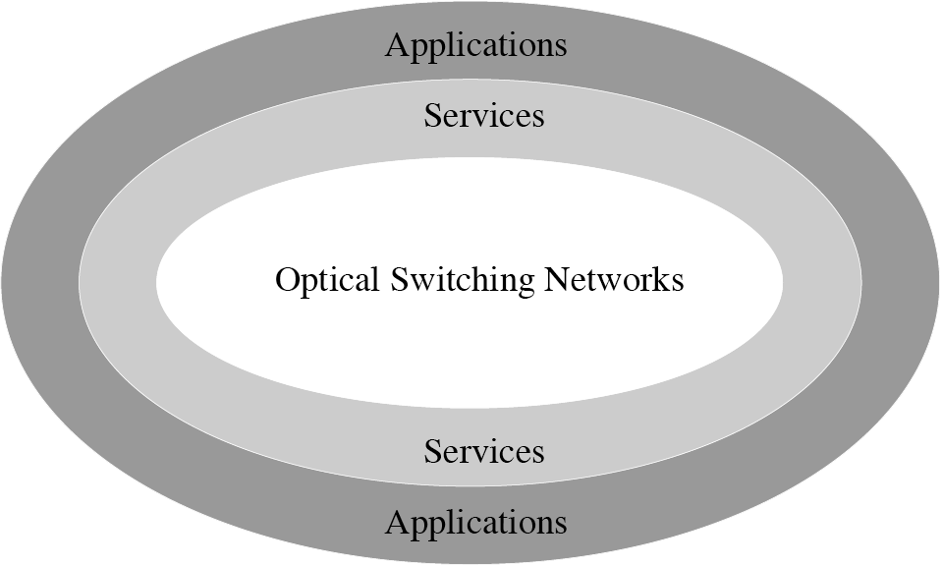
Optical switching networks
Services
  Services are offered to applications by underlying optical switching networks through dynamic connections of different switching granularity

Slide 15
Optical switching networks
Switching granularity
  Connections in optical switching networks can be categorized according to their switching granularity
  Switching granularities range from
    coarse granularity (fiber switching) to
    fine granularity (OPS)
Fiber switching
Waveband switching
Wavelength switching
Subwavelength switching
Optical circuit switching (OCS)
Optical burst switching (OBS)
Optical packet switching (OPS)

Slide 16
Optical switching networks
Switching granularities
  Fiber switching
    All data arriving on an incoming fiber is switched to another outgoing fiber
  Waveband switching
    Set of wavelength channels carried on fiber is divided into multiple adjacent wavebands, each containing two or more contiguous wavelength channels
    Wavebands arriving on the same incoming fiber are switched independently from each other
  Wavelength switching
    Special case of waveband switching
    Incoming WDM comb signal is first demultiplexed into its individual wavelength channels
    Each wavelength channel is then switched independently

Slide 17
Optical switching networks
Switching granularities
  Subwavelength switching
    Wavelength channel interleaved by means of TDM => optical TDM (OTDM)
    In OTDM networks, each time slot carries data of different client and may be switched independently at subwavelength granularity
  Optical circuit switching (OCS)
    All aforementioned switching techniques are OCS techniques
    In OCS networks, circuits (fibers, wavebands, wavelengths, time slots) are dedicated to source-destination node pairs & cannot be claimed by other nodes if unused
    OCS networks suffer from wasted bandwidth under bursty traffic

Slide 18
Optical switching networks
Switching granularities
  Optical packet switching (OPS)
    Unlike OCS, OPS allows for statistical multiplexing
    Efficient support of bursty traffic
    Technological challenges
      Optical RAM not feasible
      Instead, fiber delay lines (FDLs) used to realize optical buffers as recirculating fiber loops
      FDLs have several shortcomings
        Restricted reading/writing
        Increased delay for small-size packets => OPS networks favor (fixed-size) cell switching

Slide 19
Optical switching networks
Switching granularities
  Optical burst switching (OBS)
    OBS aims at combining strengths of OCS & OPS while avoiding their drawbacks
    Operation of OBS networks
      Network ingress nodes aggregate client data into bursts
      Prior to sending burst, a reservation control packet is sent on dedicated control wavelength channel to configure intermediate nodes
      Burst is sent after prespecified offset time such that it can be all-optically switched at intermediate nodes in cut-through fashion
    OBS allows for statistical multiplexing & QoS
    Unlike OPS, OBS avoids need for optical RAM & FDL
    Unlike OCS, OBS deploys one-way reservation

Slide 20
Optical switching networks
Interlayer networking
  Aforementioned switching paradigms work at data plane of optical switching networks
  Control plane needed for coordinating various switching techniques efficiently
  Two approaches to realize control plane
    Design of new control protocols taking properties of optical switching networks into account
    Extension of existing control protocols used in electronic data networks
  Following the latter approach, adoption of IP signaling & routing protocols has been receiving much attention from both industry & academia
  IP-centric control plane enables IP clients to dynamically set up, modify, and tear down lightpaths in AONs => flexible & resilient IP/WDM networks with interlayer networking between AONs & IP clients

Slide 21
Optical switching networks
Interconnection models
  IP & optical networks interwork according to inter-connection models
    Peer model
      Integrated IP & optical networks with unified control plane
      IP routers & OXCs/OADMs act as peers => exchange of full routing information, giving rise to security issues
    Overlay model
      IP & optical networks operate completely independently, running different sets of control protocols
      Interfaces between both networks must be standardized
    Interdomain (augmented) model
      IP & optical networks have their own routing instances
      Optical networks provide reachability information of IP routers to IP clients

Slide 22
Optical switching networks
Optical control plane standardization
  ITU-T ASTN/ASON
    Automatic switched transport/optical network (ASTN/ASON) framework for control plane
    Deals with network functions (e.g., autodiscovery of network topology & resources) and interfaces [e.g., optical user-network interface (O-UNI)]
  IETF GMPLS
    Generalized multiprotocol label switching (GMPLS) routing & signaling protocols to set up & tear down connections through O-UNI
  OIF O-UNI functionality
    O-UNI functionality assessed in Optical Internetworking Forum (OIF)
  T1X1 O-UNI requirements
    O-UNI requirements determined in T1X1 together with ITU-T

Slide 23
Optical switching networks
Customer-controlled networks
  ASON concepts & GMPLS protocols well suited for conventional centrally managed optical networks
  Customer-managed & customer-controlled optical networks are interesting alternative
    Customers acquire, control, and manage own dark fibers and optical network equipment independent from any carrier => “condominium” networks
    Potential cost savings by replacing monthly expenditures with one-time initial expenditure shared by customers
    Customers can freely select network control & management systems without giving visibility to any carrier
    Well suited to support data-intensive applications (e.g., Grid computing)
    Increasingly common among large enterprise networks, research networks, and government departments

Slide 24
Optical switching networks
Security
  Many security mechanisms used in electronic networks can also be applied at higher electronic protocol layers of optical switching networks (e.g., AAA, encryption)
  Specific security issues in optical switching networks
    Malicious signals harder to detect due to transparency
    Susceptible to QoS degrade or even service disruption due to technological limitations of current optical components & devices, e.g.,
      Gain competition in EDFA lets malicious high-power optical signals use more upper-state photons => reduced gain of other user signals
      Limited crosstalk of optical devices (OADM, OXC) may reduce QoS on one or more wavelength channels
    Attacks can be easily launched from remote sites due to small propagation loss

Slide 25
Optical switching networks
Grooming
  Most previous work was done in SONET/SDH ring networks to bypass intermediate ADMs & reduce number of ADMs
  Traffic grooming can be extended to optical mesh networks
    Assigning low-rate circuits & data flows to optically bypassing wavelength channels
    Reducing number of wavelength channels & nodal processing
    Cost savings
    Performance improvements (e.g., decreased blocking probability)
  Future challenges
    Degree of required opacity (number of dropped wavelengths)
    Exploitation of topological properties (e.g., star, tree)
    Study of more realistic traffic patterns (e.g., hot-spot, multicast)

